Slide 1

Towards 6G
Magnus Frodigh, VP Head of Ericsson Research
Notes:
Thanks for inviting me to the 5G++ Online summit in Dresden
My name is …
Happy to talk to all of you from our Ericsson Studio. My key note is about taking 5G to 6G with a special focus on the Digitalized and programmable world we see in front of us.

Slide 2
5G uptake faster than expected Ericsson Mobility Report, 2026 prediction
Fast Responsive Reliable
3.5bn
40%
8.8bn
subscriptions
of mobile subscriptions
mobile subscriptions
5G
for Consumers & Enterprise
53%
60%
5.4bn
share of mobile data traffic
coverage of World’s pop
Cellular IoT connections
Notes:
We also expect the continued 5G uptake up to be fast. By 2026 we predict that …
Specially interesting is the new use cases around primarily focus on connections besides the MMB subscriptions. We are in the beginning of the exponential uptake of cellular IoT connections.

Slide 3
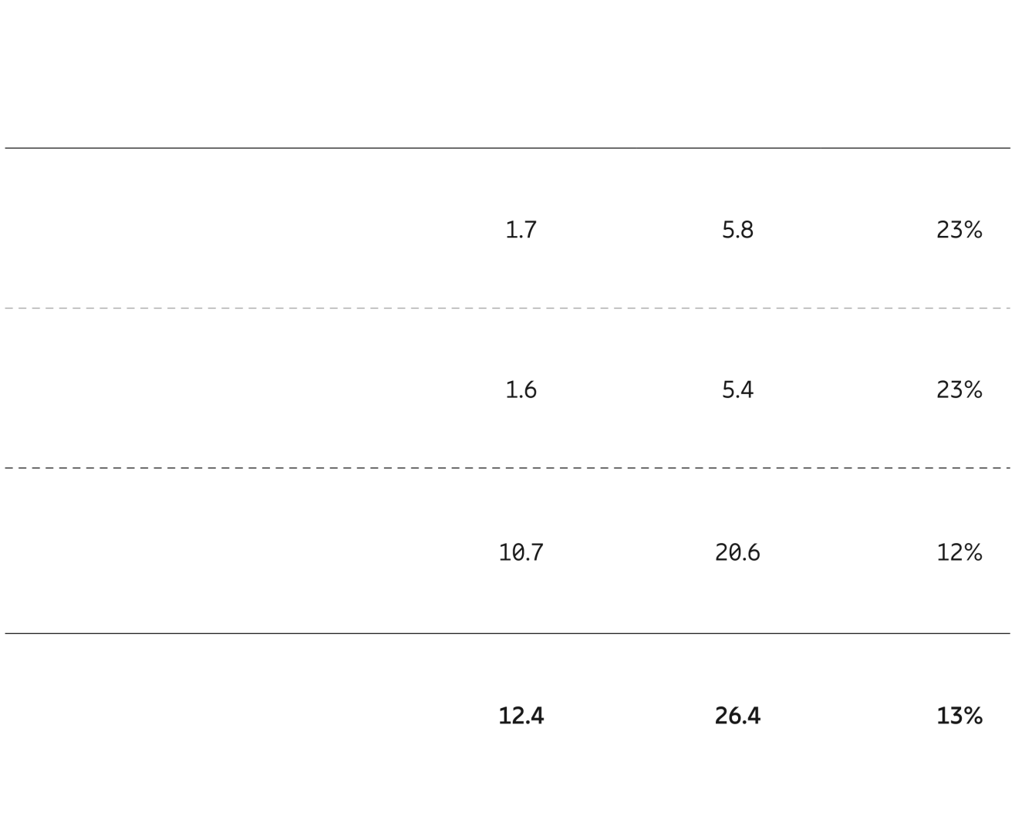
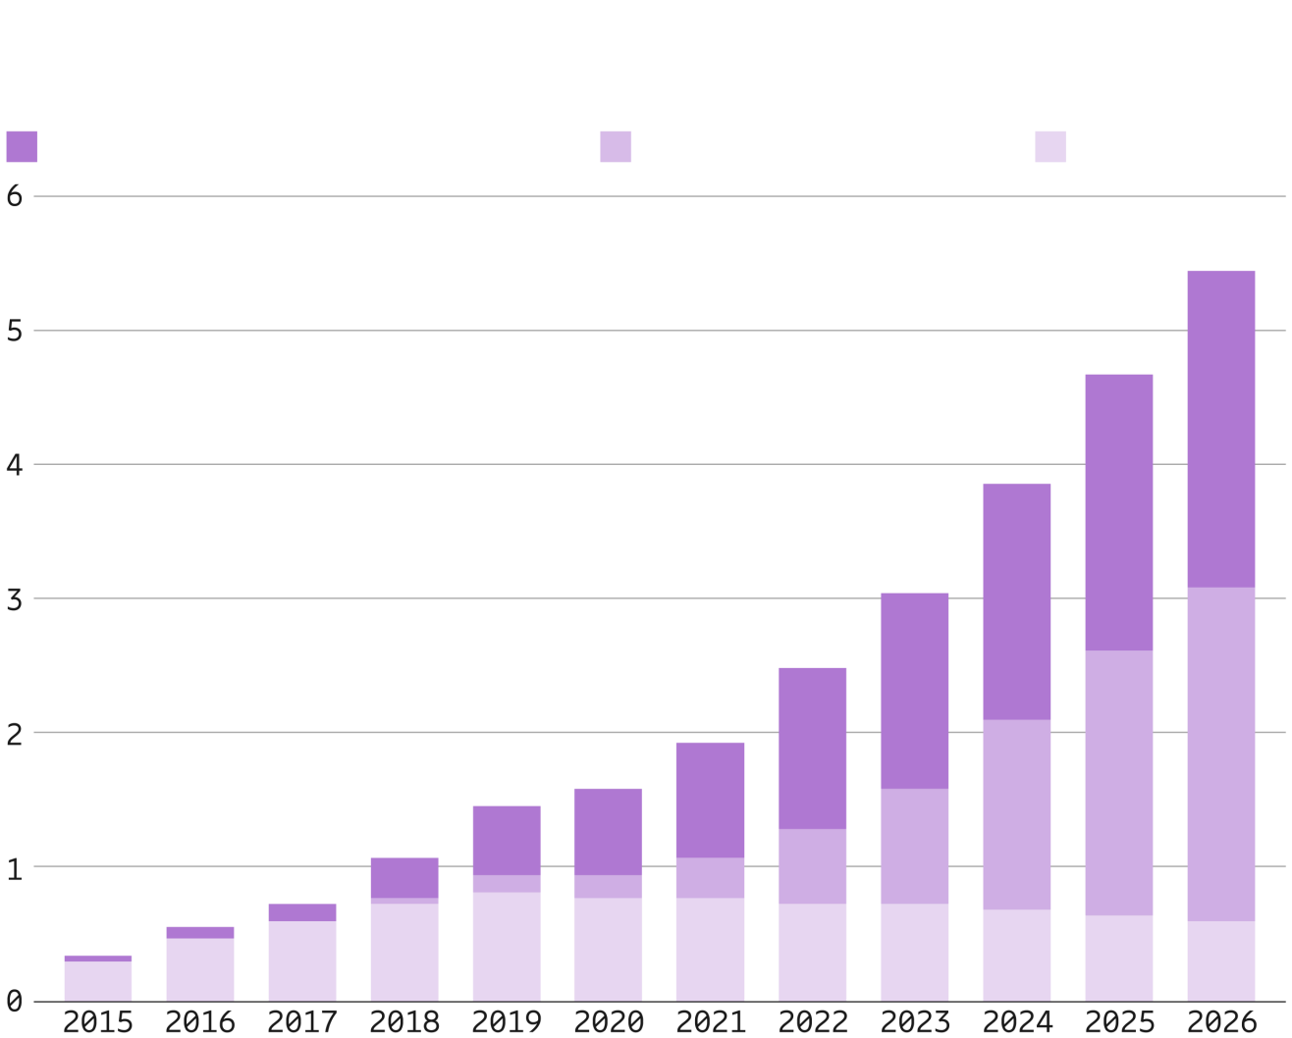
Cellular IoT to reach 5.4 billion connections in 2026
IoT connections (billion)
Cellular IoT connections by segment and technology (billion)
IoT
2020
2026
CARG
Broadband IoT and Critical IoT (4G/5G)
Massive IoT (NB-IoT/Cat-M)
Legacy (2G/3G)
Wide-area IoT
Cellular IoT*
Short-range IoT
Total
* These figures are also included in the figures for wide-area IoT.
Notes:
**********************************************************
Slide owner: GFMC SCM
Source: Ericsson Mobility Report, June 2021
Latest update: June 2021
Best before: November 2021
**********************************************************
The Massive IoT technologies NB-IoT and Cat-M1 continue to be rolled out around the world, with the number of connections expected to increase by almost 80 percent during 2021 to reach close to 330 million. In 2026, these technologies are forecast to make up 46 percent of all cellular IoT connections.
During 2021, broadband IoT (4G/5G) will overtake 2G and 3G together as the segment that enables the biggest share of IoT applications.
The removal of inactive cellular IoT connections in China indicates a substantial share of inactive connections, leading us to revise our estimate for 2020 from 1.7 billion to 1.6 billion cellular IoT connections and adjust the overall forecast accordingly.

Slide 4


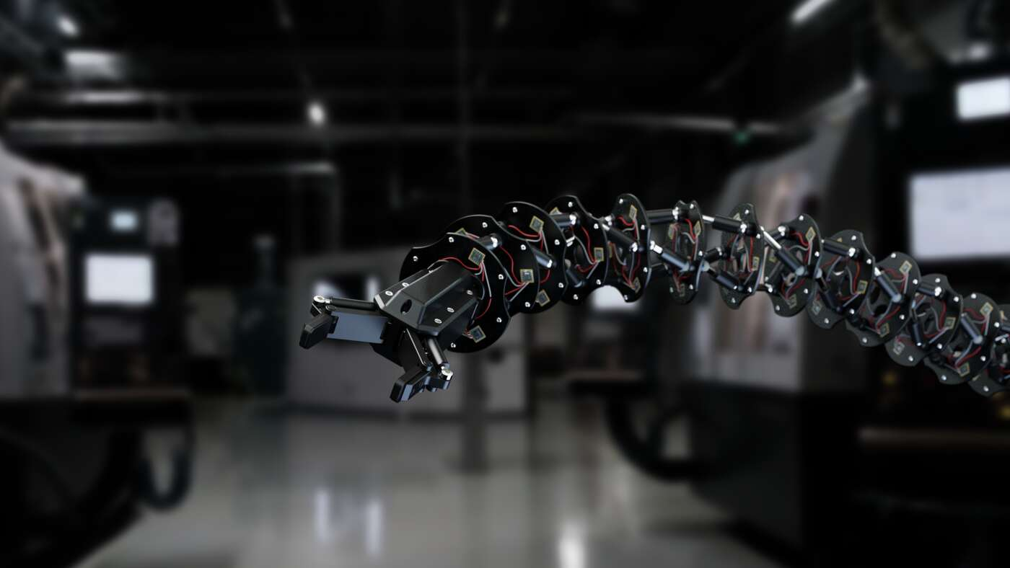
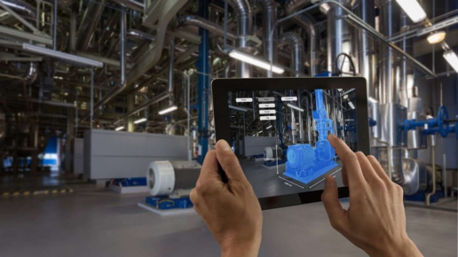
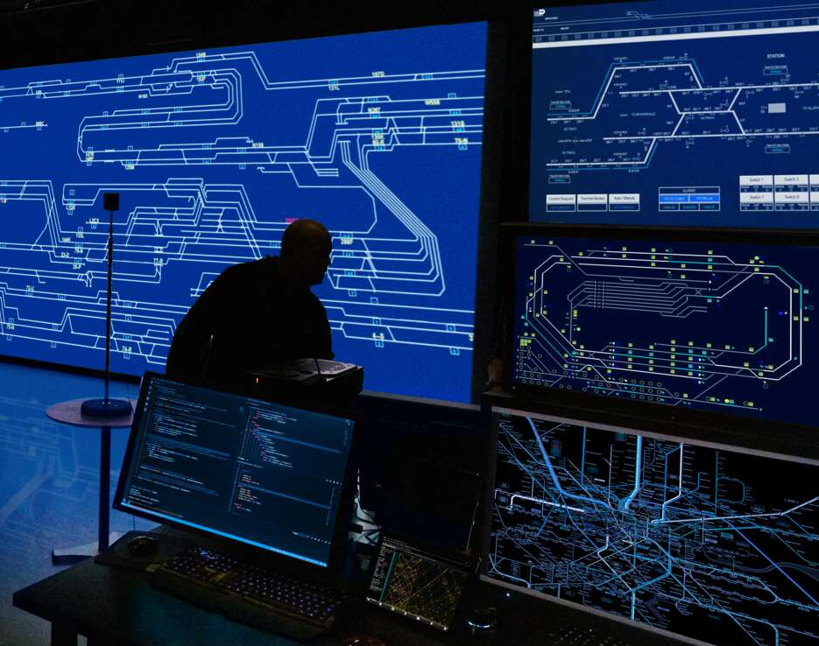

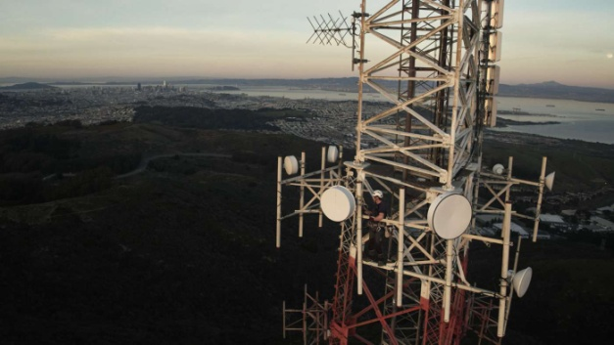

2030 use case examples
Use case scenarios enabled by the network platform
The Internet of Senses
Connected Intelligent Machines
Digitalized & programmable physical world
Connected sustainable world
Use case focus
Limitless connectivity
Trustworthy Systems
Cognitive network
Network compute fabric
Technology focus
Technology scenarios evolving the network platform

Slide 5



6G – Moving in a cyber-physical continuum
Programmable digital representation of the physical world
Cyber-physical continuum
Vast amounts of sensors embedded in physical world send data to update the digital representation in real time
Connected intelligent machines
Actuators in the real world carry out functions that is programmed in the digital representation
Digital world
Internet of senses
Physical world
The network provides intelligence, ever-present connectivity, and full synchronization in a cyber-physical continuum
Digitalized & programmable physical world
Connected sustainable world
The physical world of sensing, action, and experience
Trace back and analyze
Observe and act in real-time
Simulate, predict and program
Past
Future

Slide 6
Tech scenarios evolving the network platform
Use case scenarios enabled by the network platform
The Internet of Senses
Connected Intelligent Machines
Digitalized & programmable physical world
Connected sustainable world
Use case focus
Limitless connectivity
Trustworthy Systems
Cognitive network
Network compute fabric
Technology focus
Technology scenarios evolving the network platform

Slide 7

Limitless connectivity
Network adaptability
Enable rapid network deployment, and quick introduction of new services
E2E functions
Leverage future high-performance connectivity to all applications as well as mutual awareness between the application and the network
Extreme performance
Delivers extreme performance anywhere to existing and novel use cases when requested
Embedded devices everywhere
Serve new types of devices that will be embedded into everything

Slide 8












6G research initiatives
China
IMT-2030 promotion group
MOST
Future forum
Europe
ICT-52
Horizon Europe (coming)
National programs
USA
ATIS
RINGS
Korea
6G R&D strategy
5G Forum
Japan
6G promotion strategy
IOWN
Notes:
9/16/20212011-10-19
8

Slide 9
Ericsson 6G white paper
Released November 6 (link)
Presents Ericsson’s 6G vision for 2030 - a broad view covering our ongoing explorative research
Ericsson whitepaper
GFTL ER
November 2020
Ever-present intelligent communication – A research outlook towards 6G

Slide 10
ericsson.com/future-technologies

